Slide 1
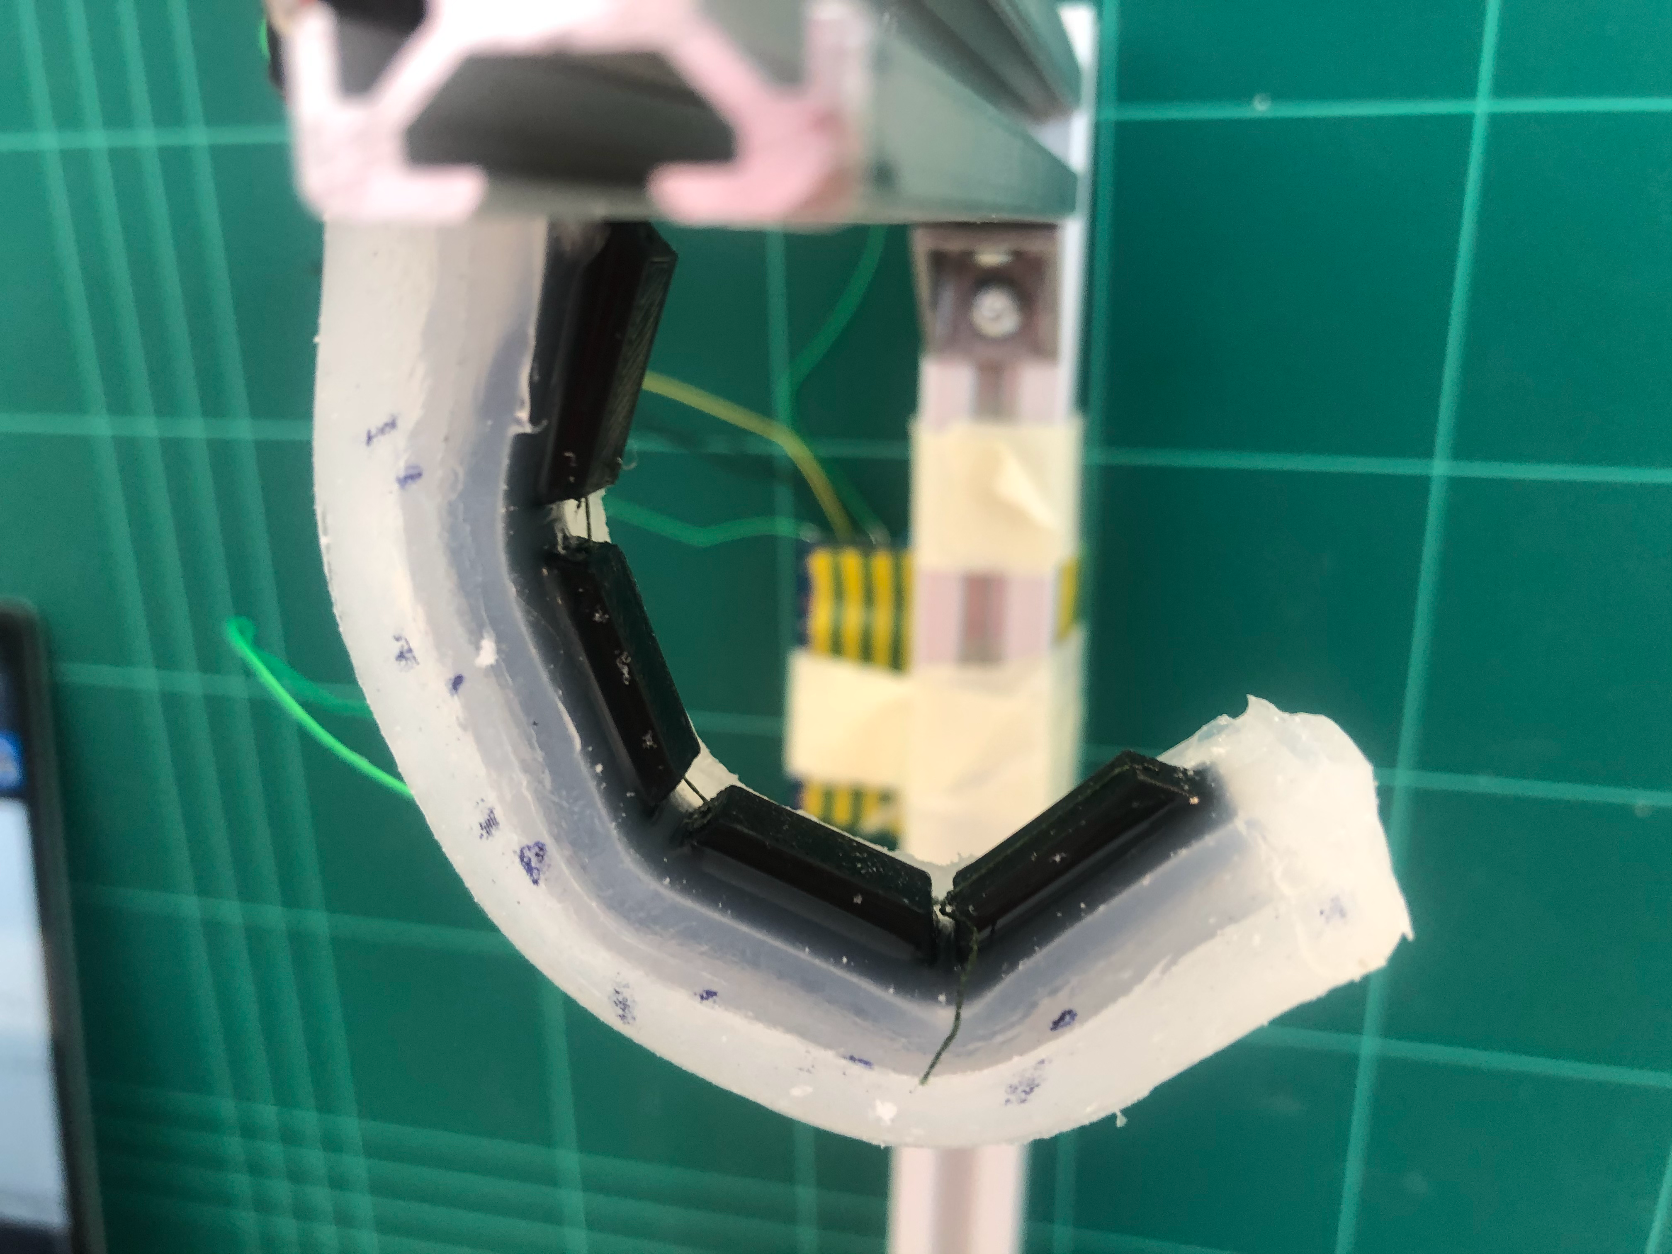
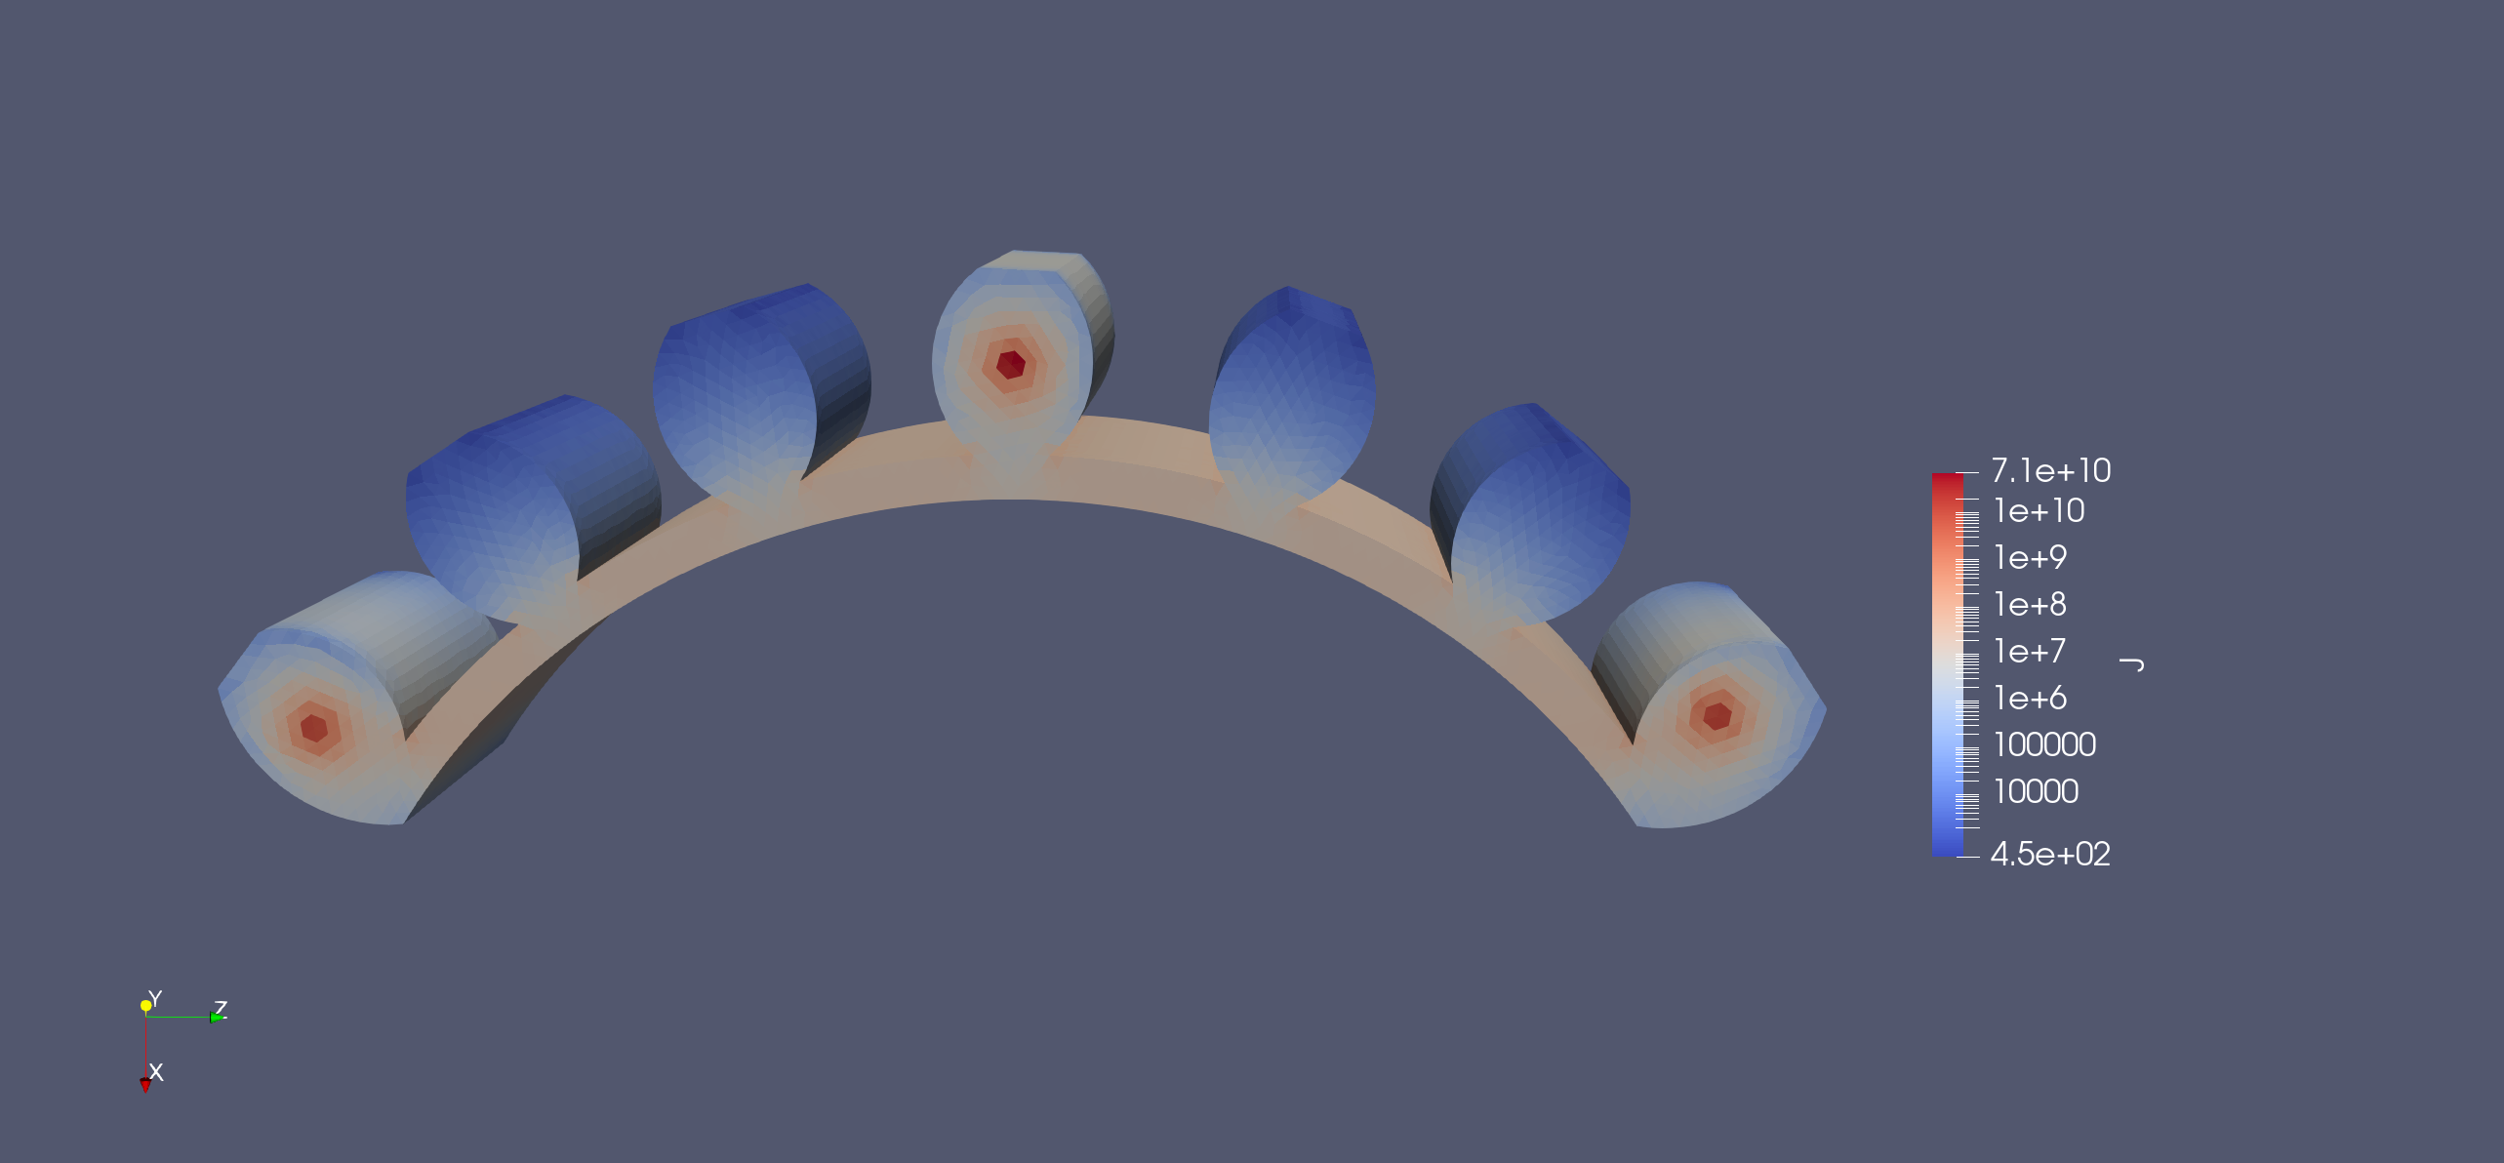
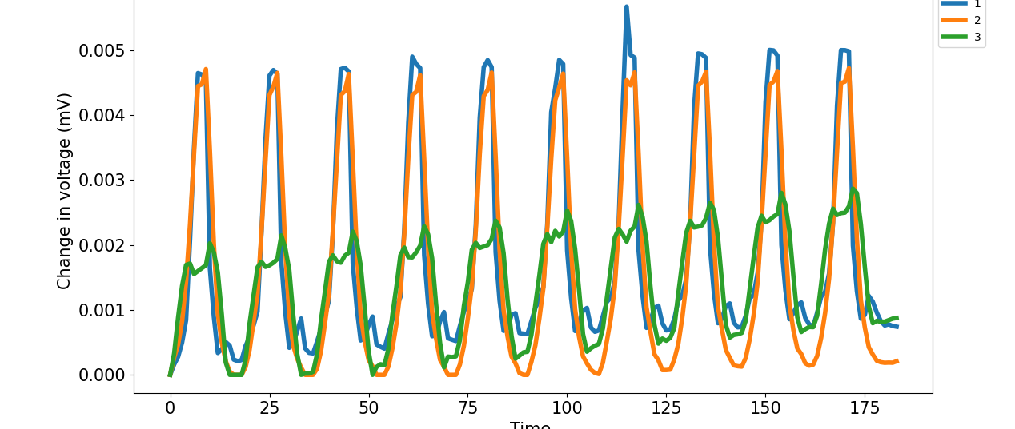
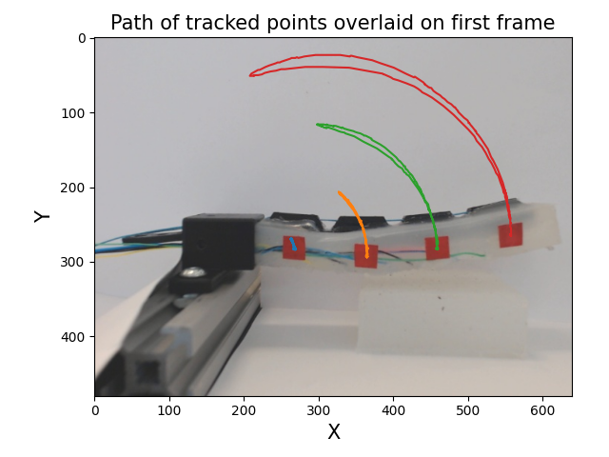
Sensing Soft Robot Shape Using Electrical Impedance Tomography
MRes thesis presentation
Charlie DeLorey
07/09/2021

Slide 2
This slide will be removed for the actual presentation, I have it here for reference
Abstract
Intro and literature review
Problem statement
State of robotics: soft vs rigid
Sensors and soft robots (grippers)
Control schemes for soft robots
Electrical impedance tomography (EIT)
Chronology of my project (simulations, silicone, hydraulic, back to silicone, data, ML, analysis and writeup)
Aims and objectives (showing a working moving soft finger that can be accurately sensed with my EIT setup to a satisfactory state)
Methodology
Integrated 3D printed hydraulic finger
SDM silicone cable-actuated finger
EIT chamber (side sections, maybe even take a picture of a cut up actuator)
Actuation (cable+stepper motor, Arduino)
Data acquisition (DAQ, electrodes, serial connection, webcam)
Software (data processing and alignment, probably some filtering for EIT data,)
Experimental setup/protocol (e.g. finger actuated 5 times, ..., finger comes in contact with object _____, ...)
Results
EIT voltage data vs cable pull length data
EIT+cable data vs ground truth camera data (get performance error)
T: Perhaps a full EIT image of the chamber in varying states of actuation
ML function learning performance/accuracy
Conclusion and discussion (a little bit)
Discussion
Conclusions and summary of my results
Future work:
How would I fix the problems I stated above
Assuming I fix my problems, what would I do with this (full grasper, add fingertips, what applications that would have, ...)
discussion off of being able to get an EIT image from my finger
Conclusion (if I have time), “I made this it does this it’s great”
References

Slide 3
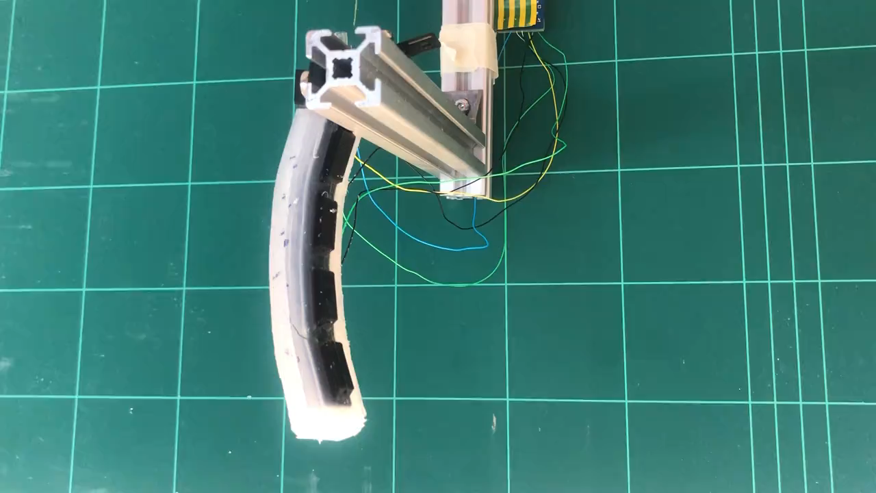
Introduction and Objectives
Sensing complications in soft robotics
Soft robots are difficult to model due to their near infinite degrees of freedom from their compliant nature
Rigid sensors would inhibit this compliant nature, preventing normal function
Proposed solution
A flexible soft sensor system that can detect soft robot actuation without impinging on normal movement

Slide 4
Methodology
EIDORS
Hydraulic actuator
SDM actuator
EIT data
Computer vision

Slide 5
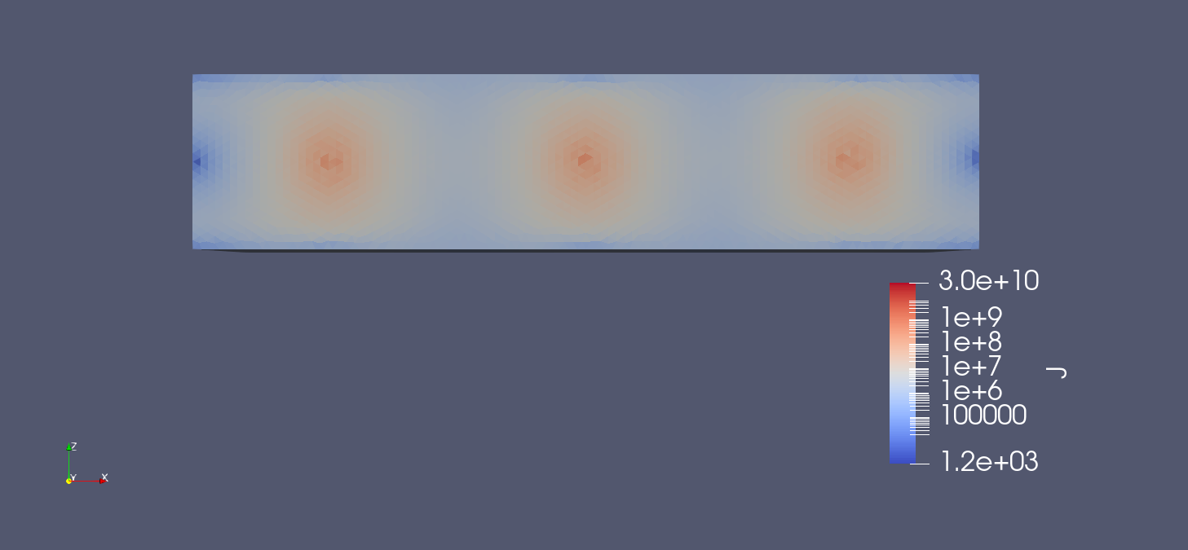
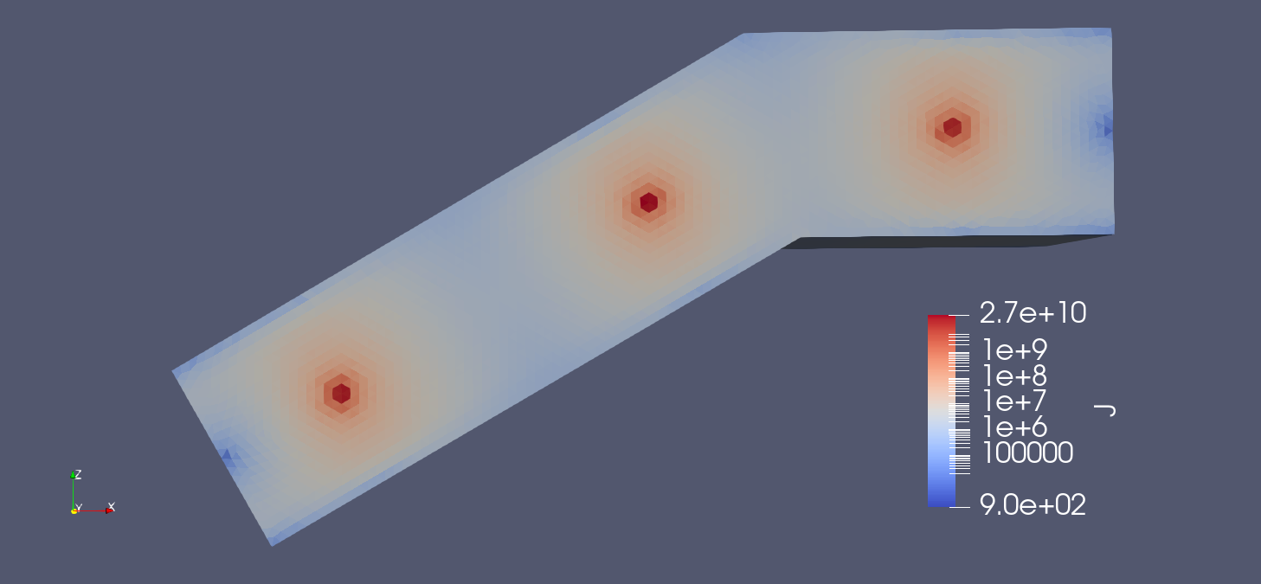
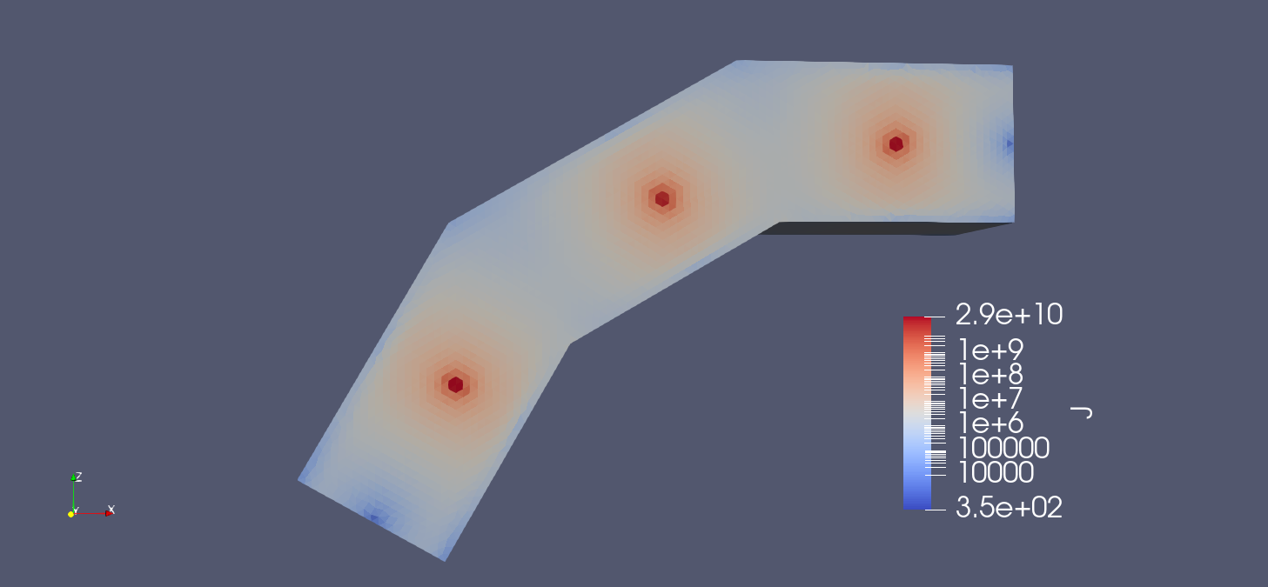
Methodology – EIDORS Simulations
(a)
(b)
No bend
Single bend
EIDORS¹ is an open-source software for simulating EIT signals
Current sources and reading points are electrodes, placed on a volume
(c)
Two bends
[1]: Andy Adler, William R B Lionheart (2006) "Uses and abuses of EIDORS: An extensible software base for EIT", Physiol. Meas. 27:S25-S42, 2006

Slide 6
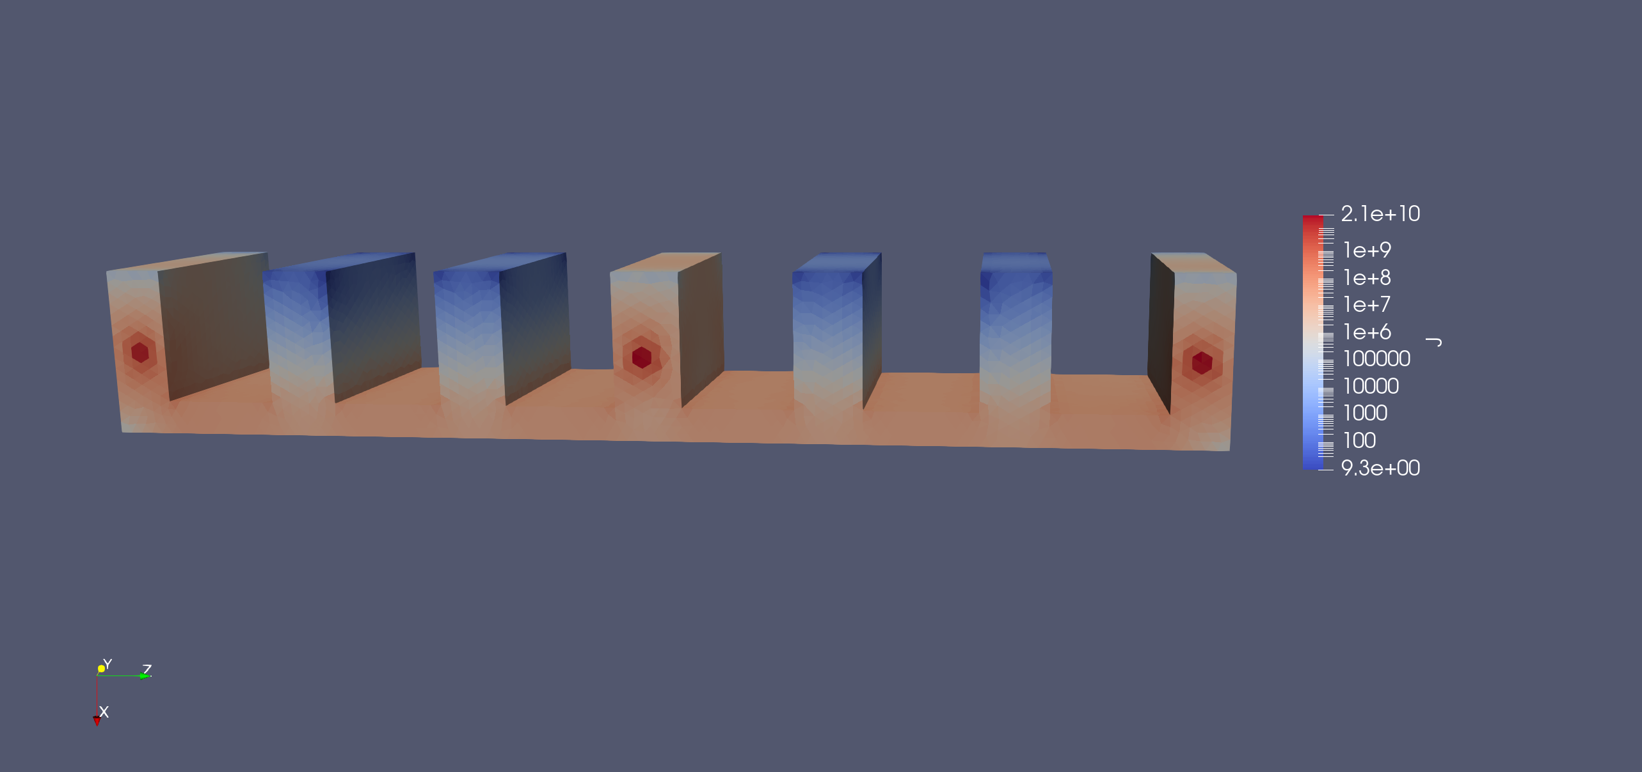
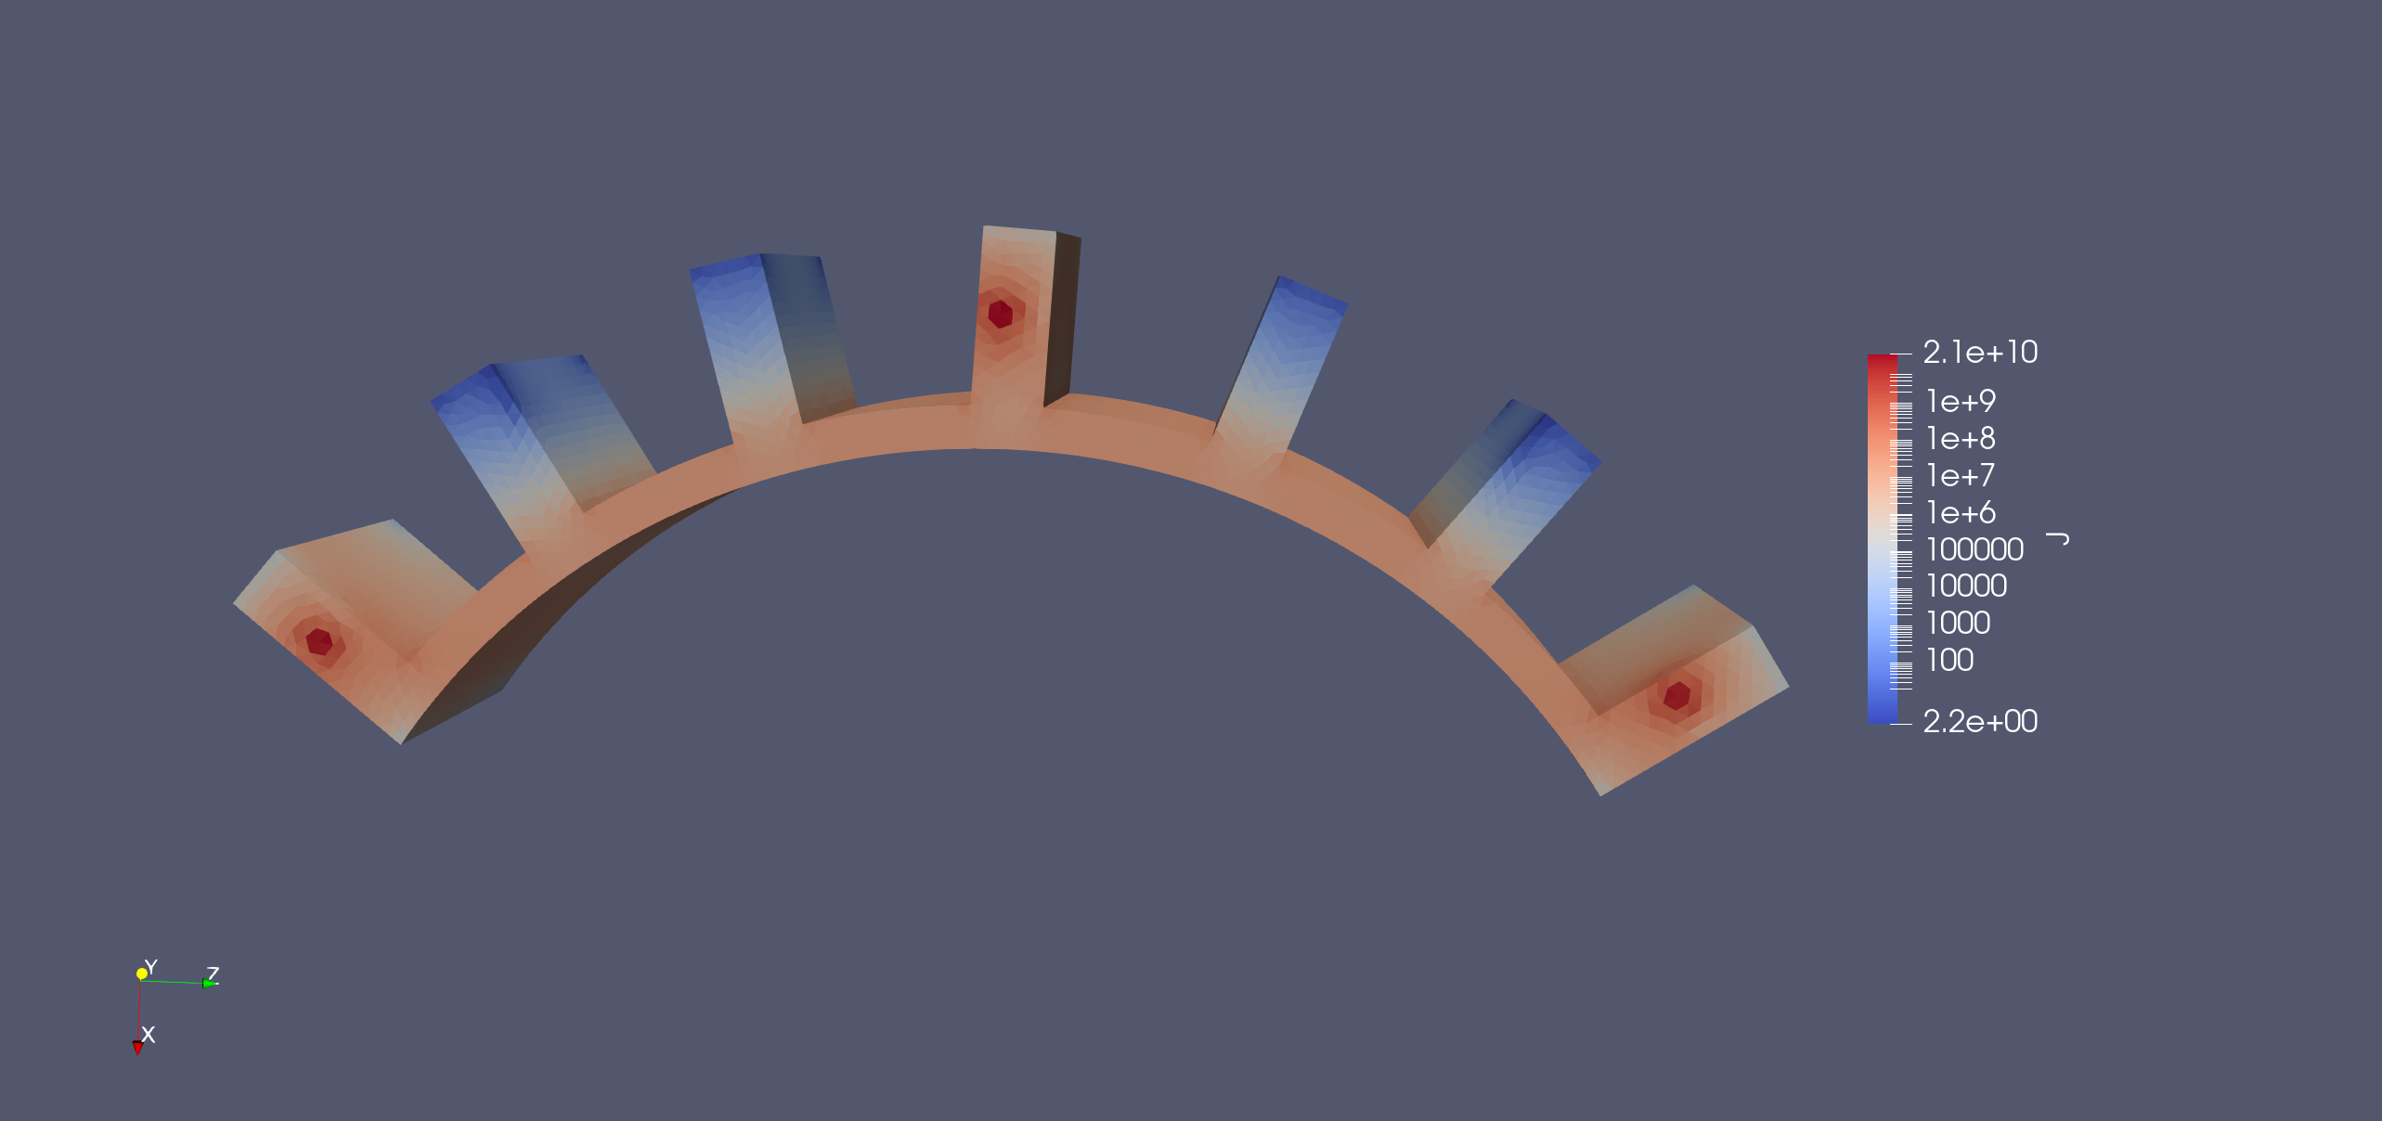
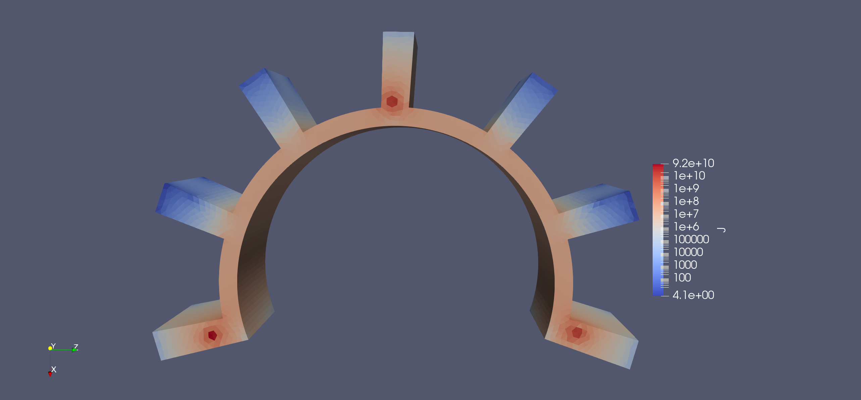
Methodology – EIDORS PneuNet simulations
(a)
(b)
(c)
No bend
Primary bend
Secondary bend
Consequent bending shows more activity along the main chamber and electrodes
Indicates placing electrodes close to bend points is beneficial
(d)
Primary bend with inflation

Slide 7
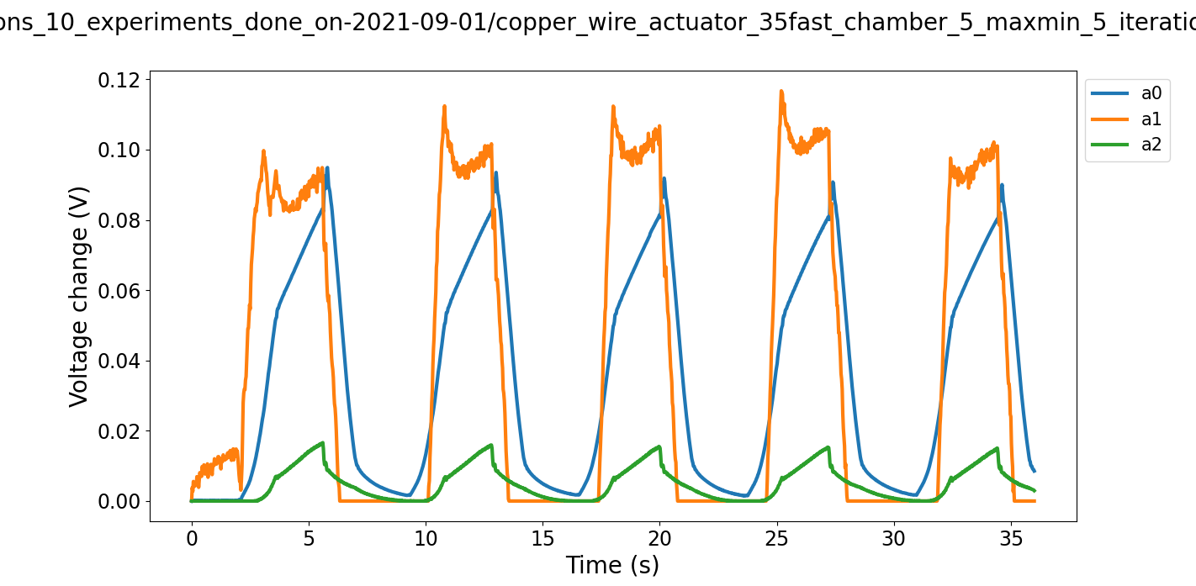
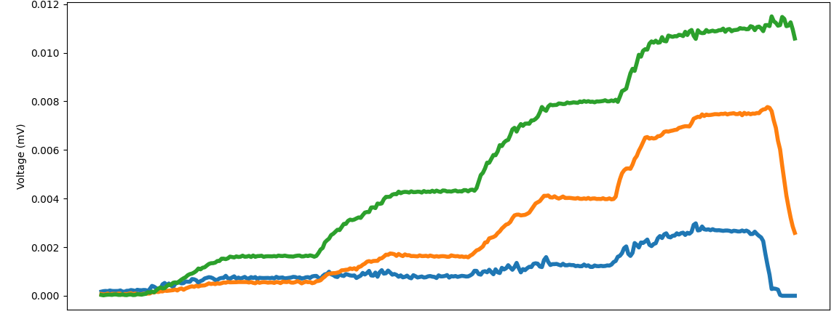
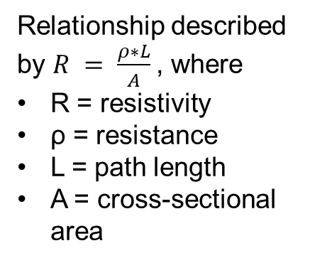
Methodology – EIT
SDM actuator incremental flexing
SDM actuator flexing (5 iterations)
Voltage signal is the result of the changing path length between electrodes within a conductive medium (0.5% saline solution)
As the path length increases, the resistivity increases
Relationship described by $R = \frac{ρ∗L}{A}$, where
R = resistivity
ρ = resistance
L = path length
A = cross-sectional area

Slide 8
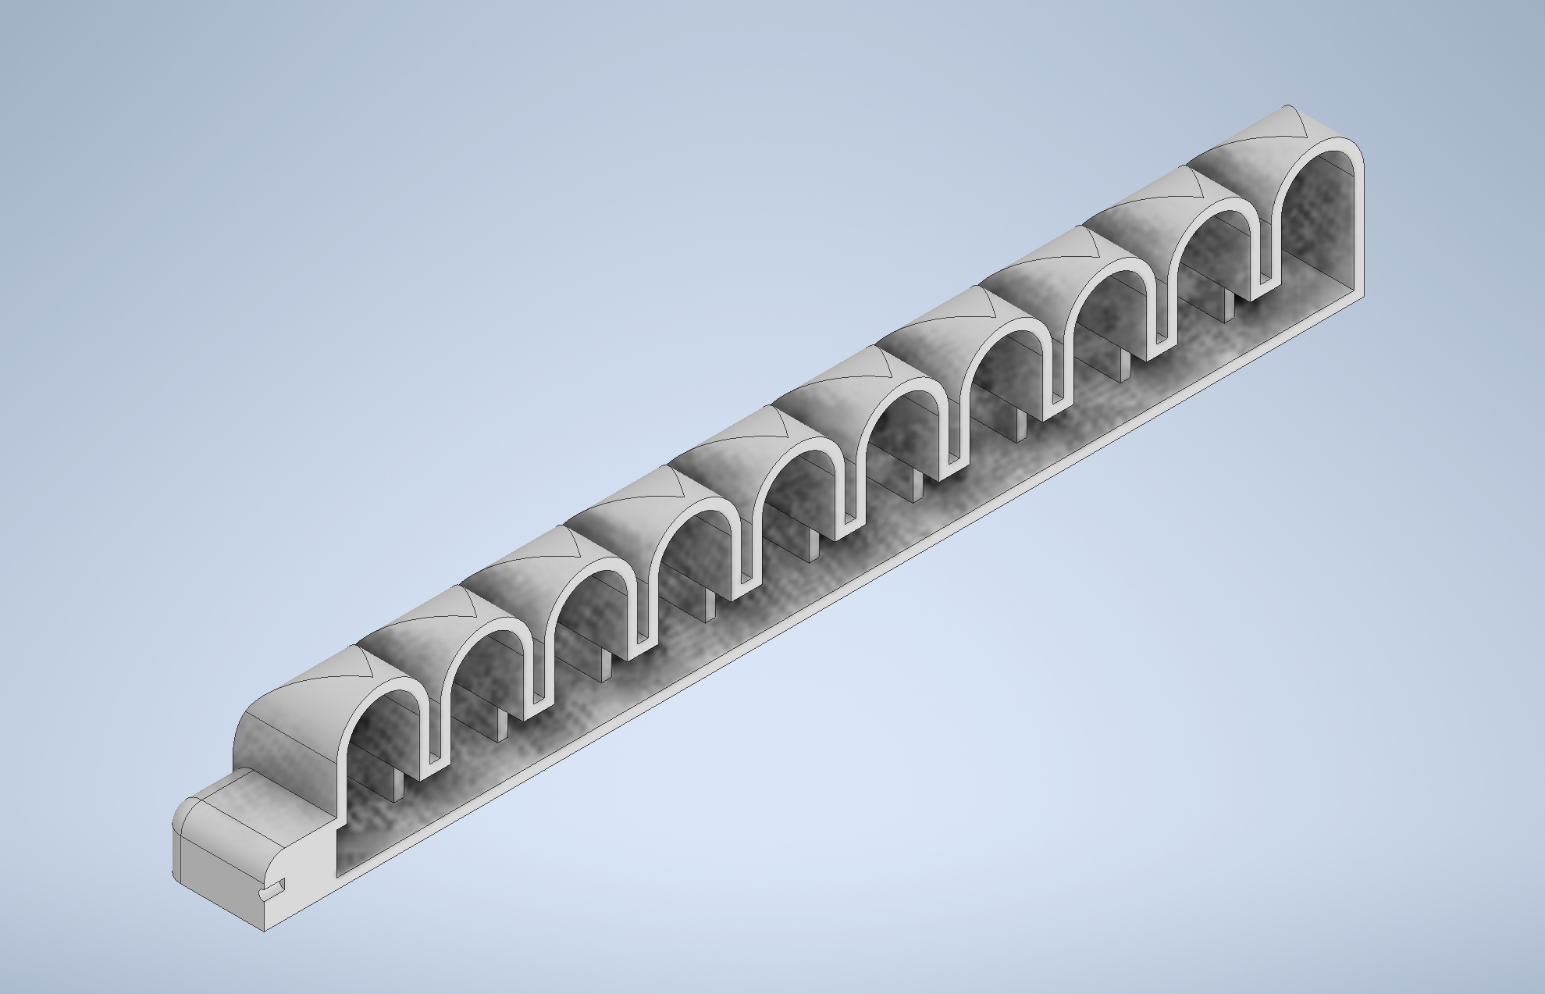
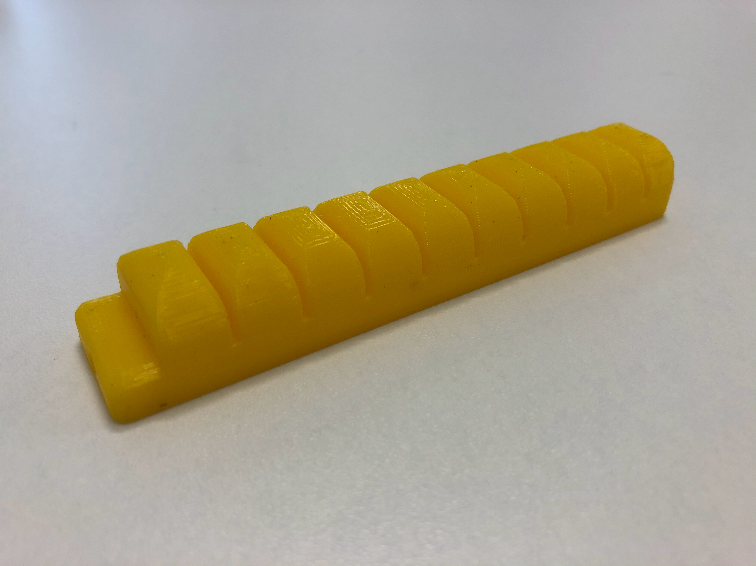
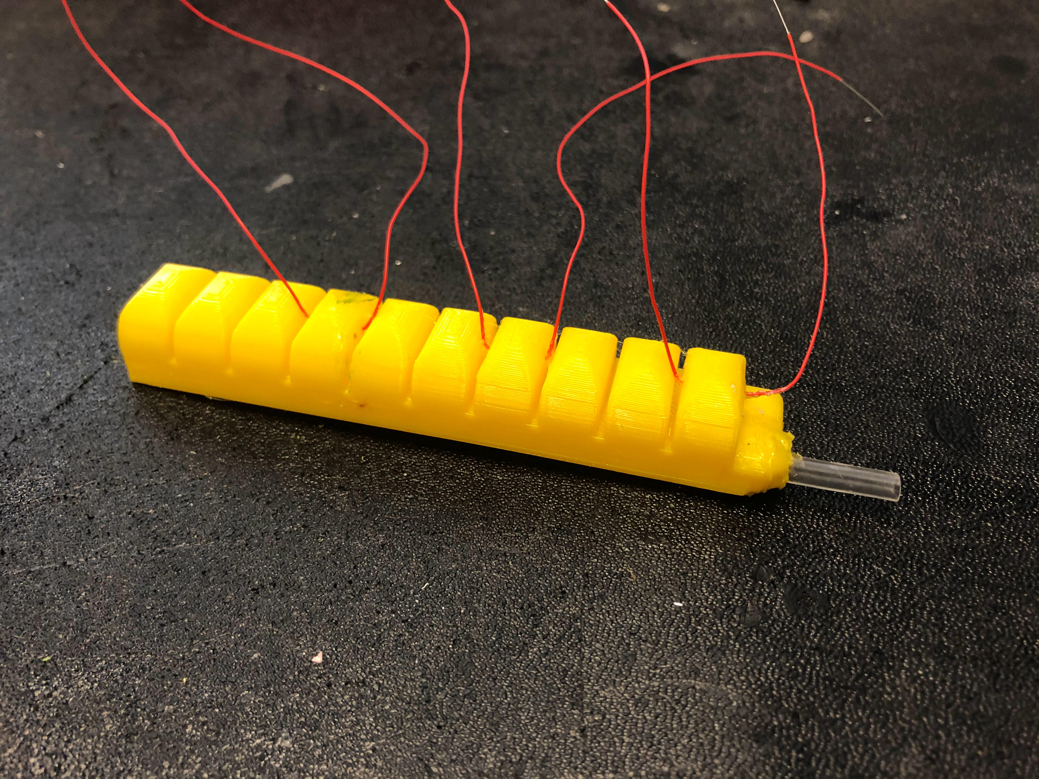
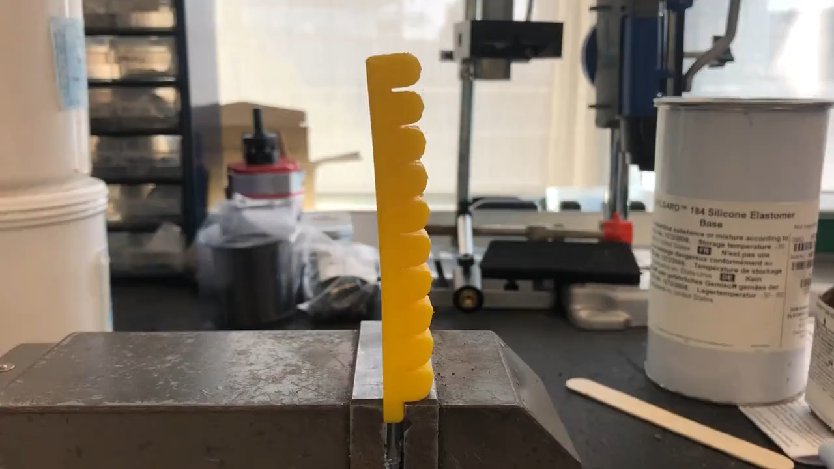
Methodology – Hydraulic actuator
Two-in-one hydraulic actuation chamber and EIT chamber
Bellows design allows smaller chambers to inflate, resulting in a bend
Issues:
3D printed material not watertight, making data inaccurate
Thickness of material prevented easy actuation
Needed high pressure to actuate
(a)
(b)
(c)
(d)

Slide 9
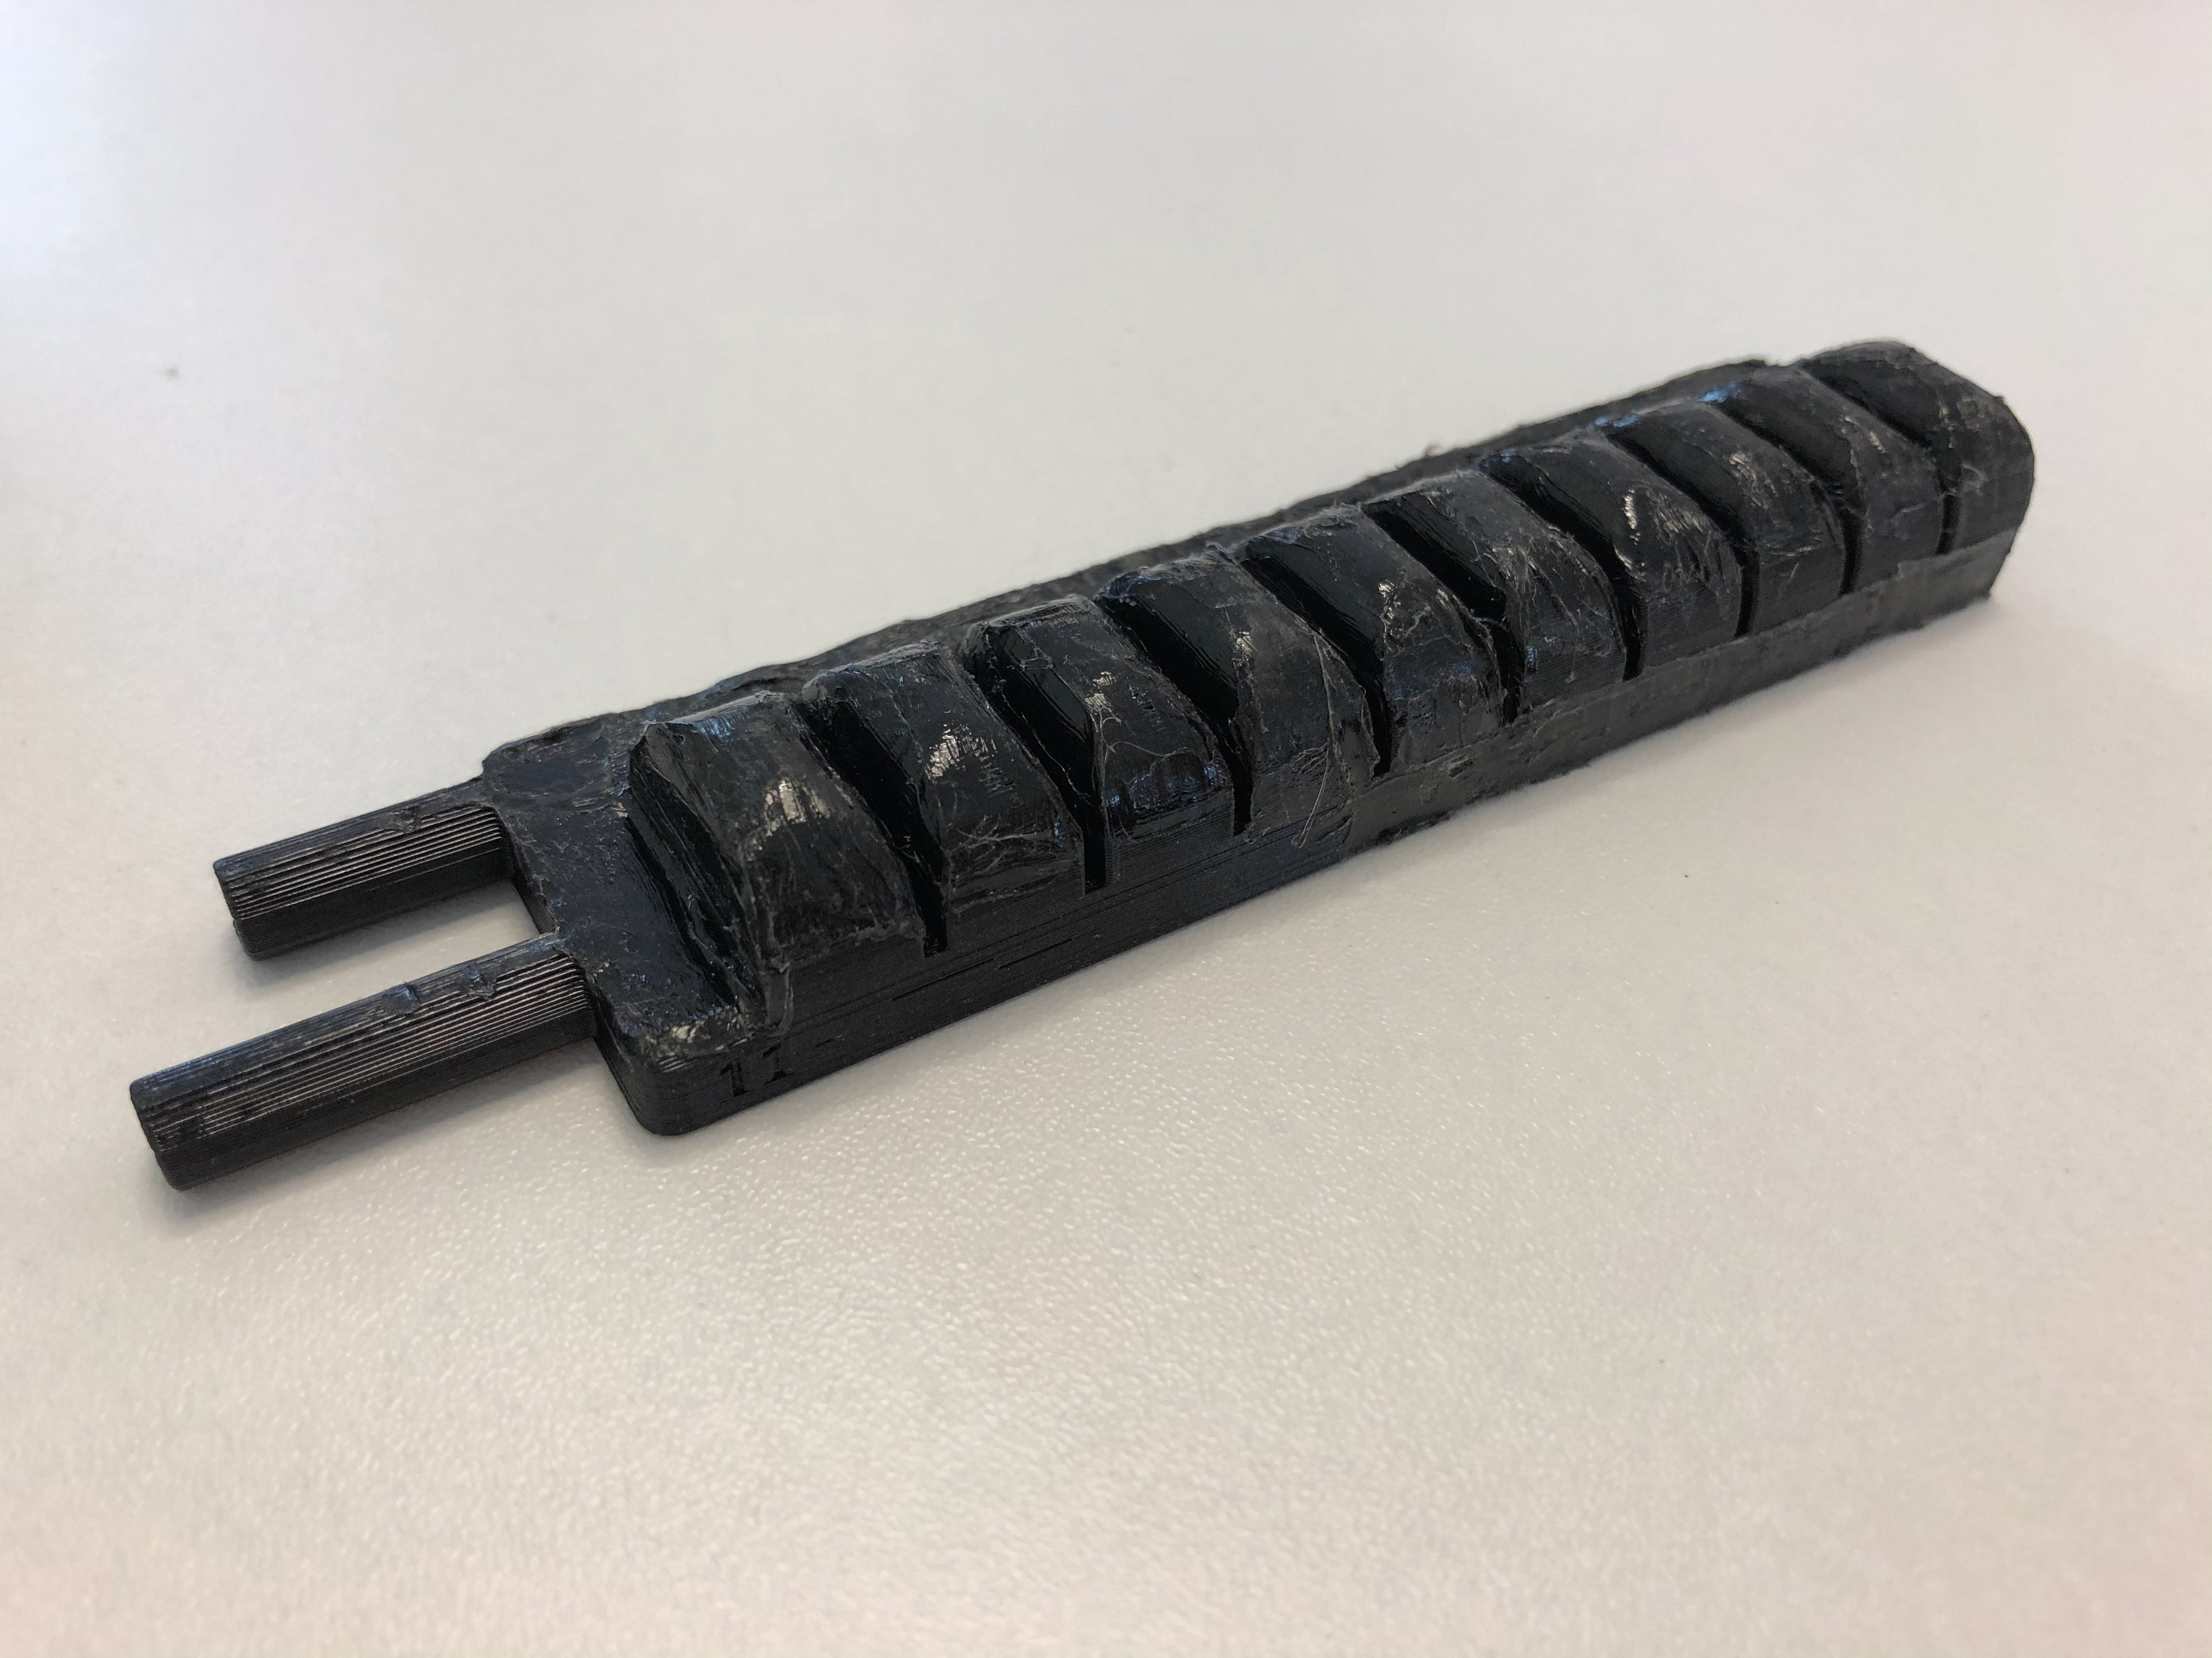
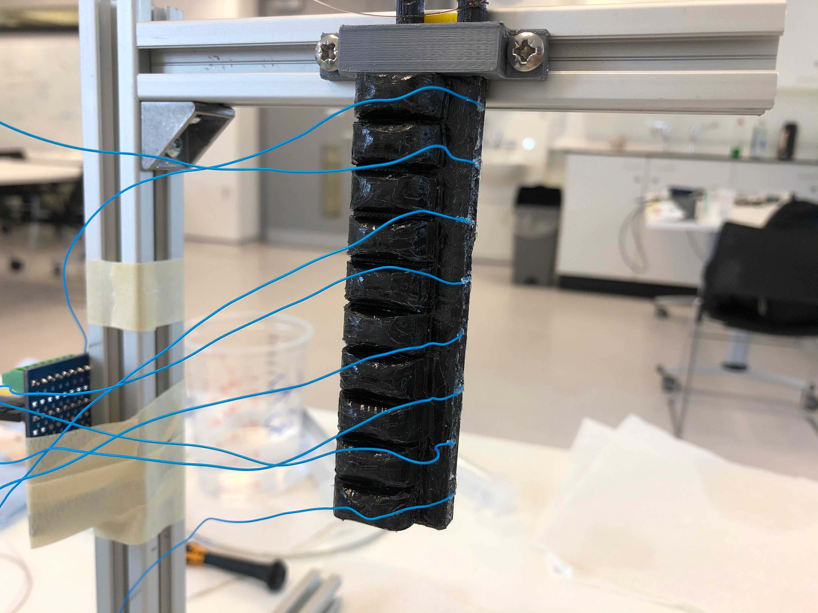
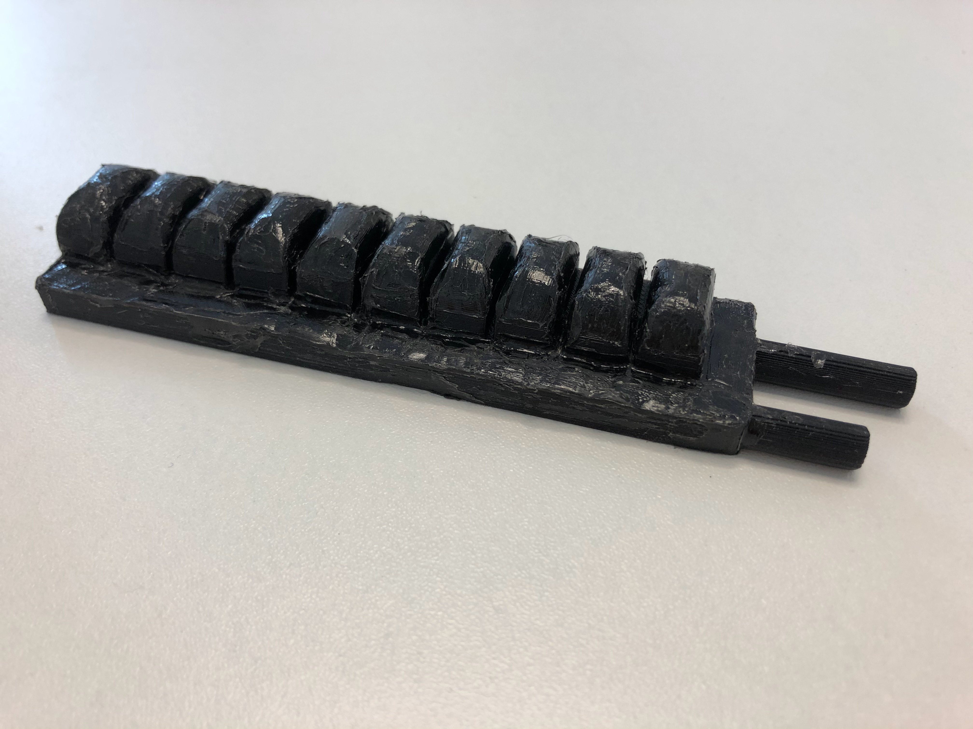
Methodology – 2-chamber pneumatic actuator
Separated EIT (liquid) and actuation (air) chambers
Frequent leaking due to imperfect 3D print, like previous iteration
Actuation chamber/bellows
(a)
(b)
Electrodes
EIT chamber
(c)

Slide 10
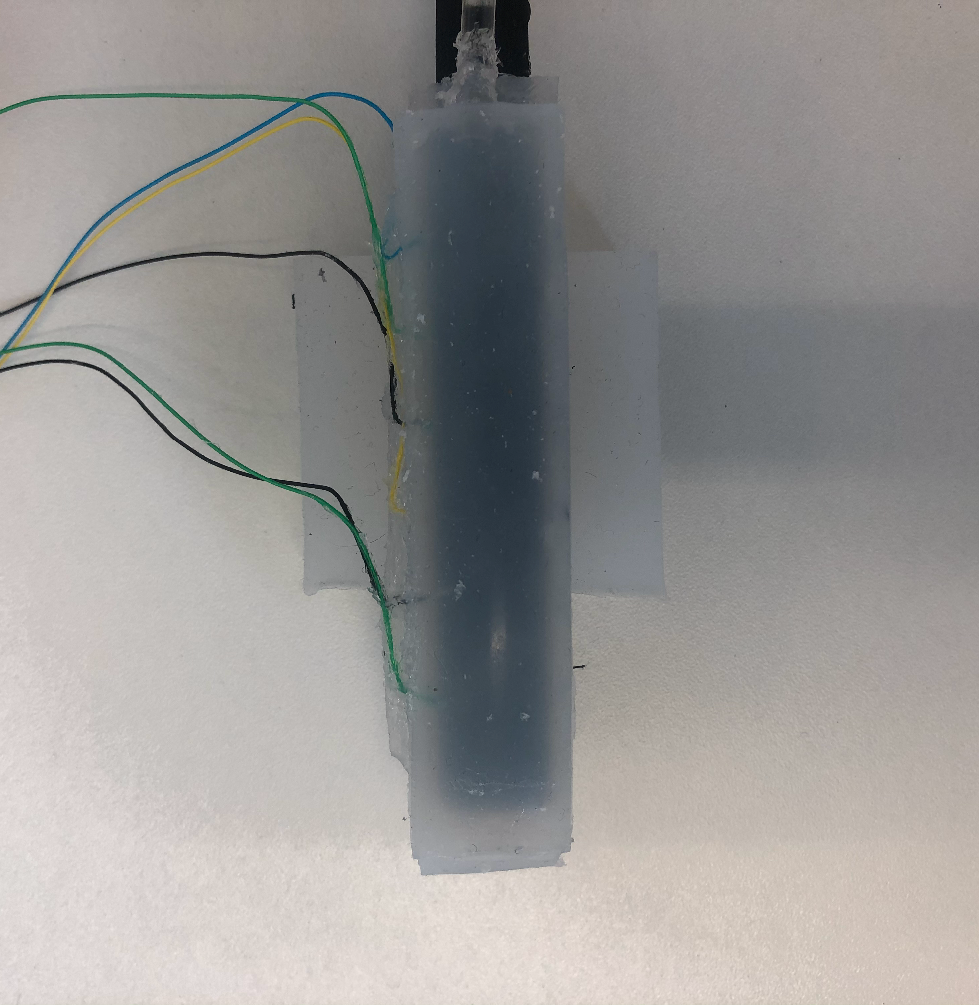
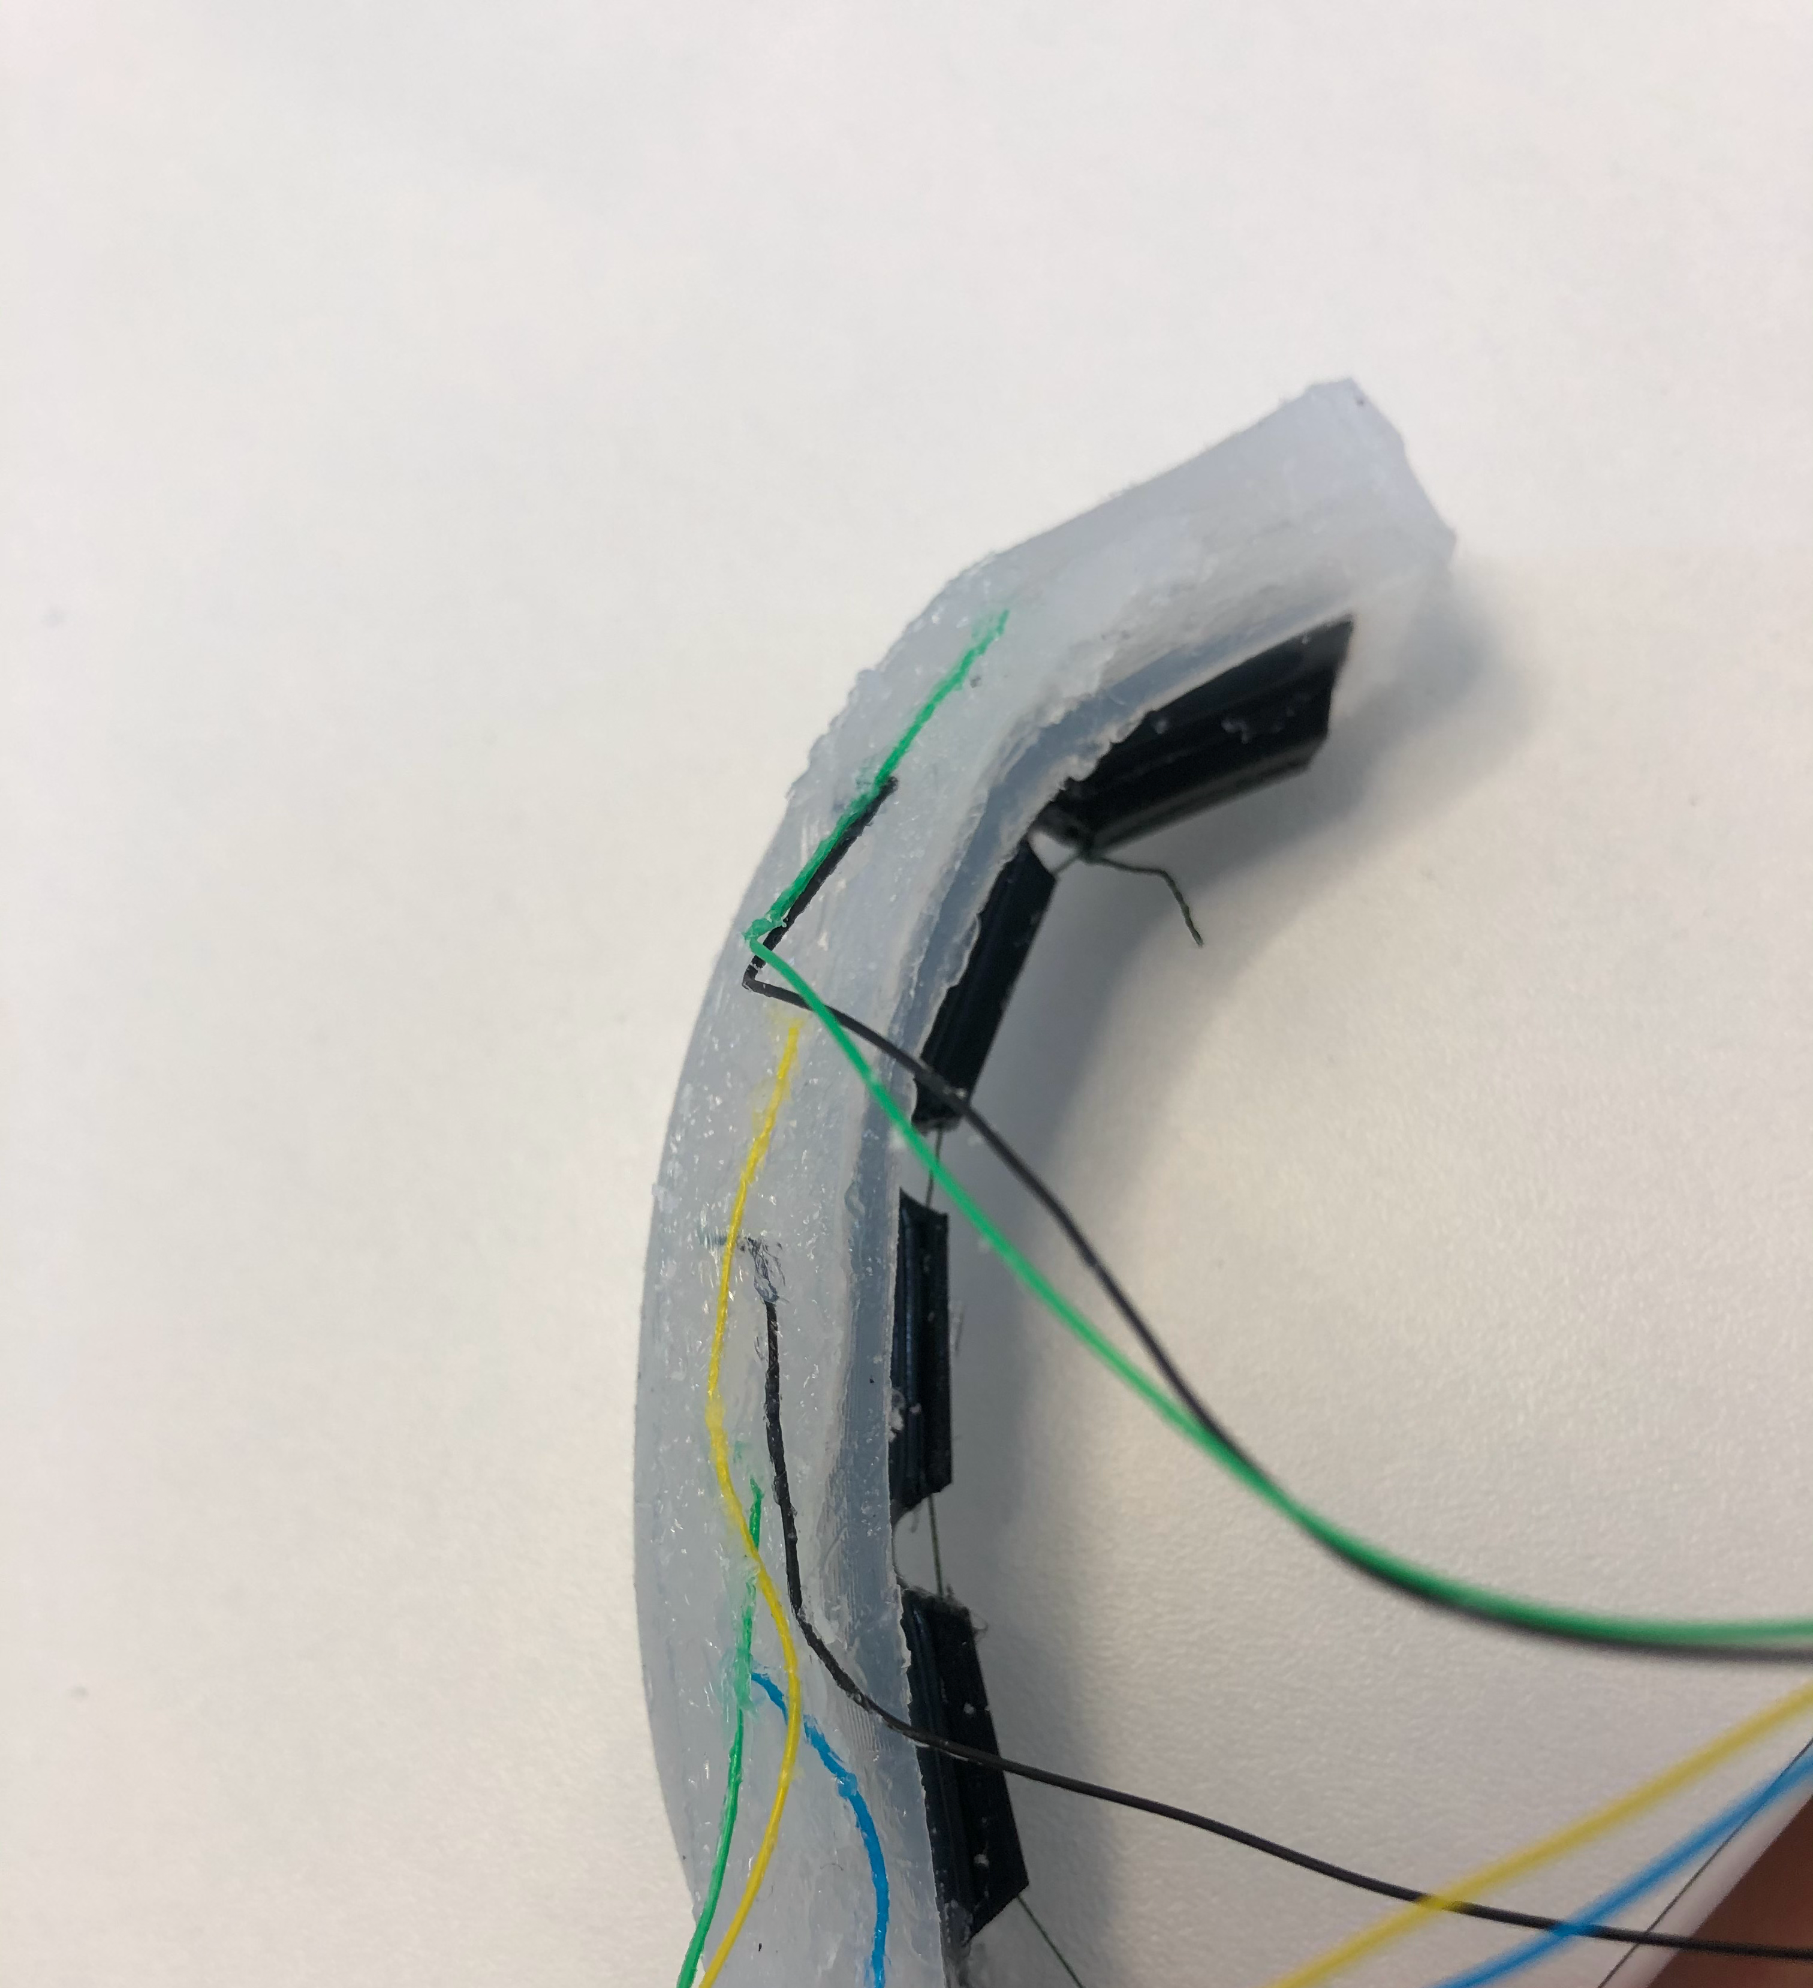
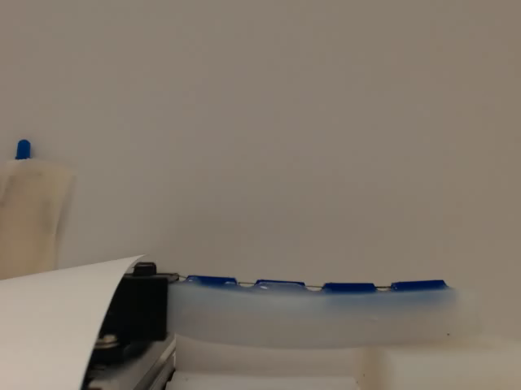
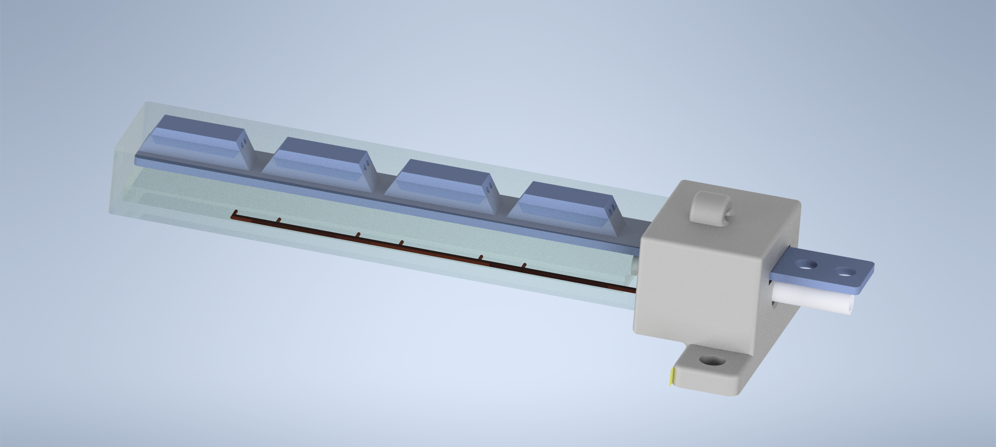
Methodology – SDM cable-driven actuator
Shape deposition modelling (SDM) cable-driven finger design
EIT chamber placed anterior running lengthwise along the finger
Cable drive provides reliable and measurable actuation with a simple design
EIT chamber
EIT chamber
Electrodes
(a)
(b)
0.5x speed
(d)
EIT chamber
(c)
Electrodes

Slide 11
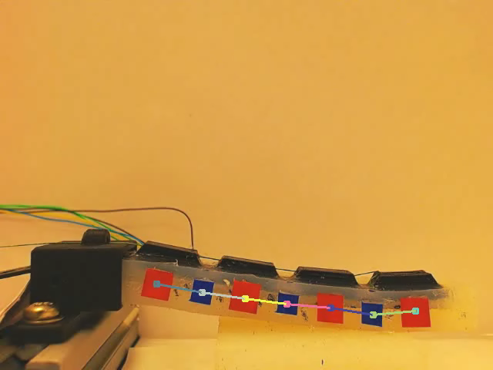
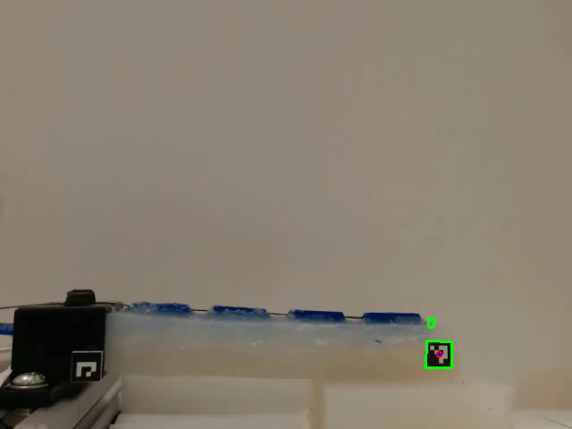
Methodology – Point tracking
(b)
Optical flow tracking
OpenCV methods used to track markers along actuator
Derived bending angle of soft robot finger
Synchronisation of video with data done with blue LED in frame
(c)
ArUco marker tracking
(a)
Pixels

Slide 12
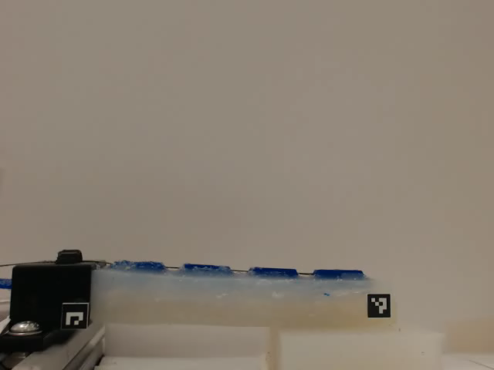
Results – Finger actuation
Physical performance of SDM actuator
**Here I am going to add an image or two of me testing the physical limits of the actuator, max bend angle, it moving something of particular mass, etc

Slide 13
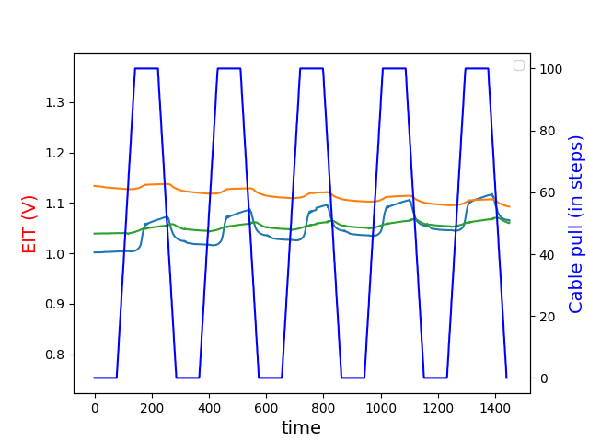
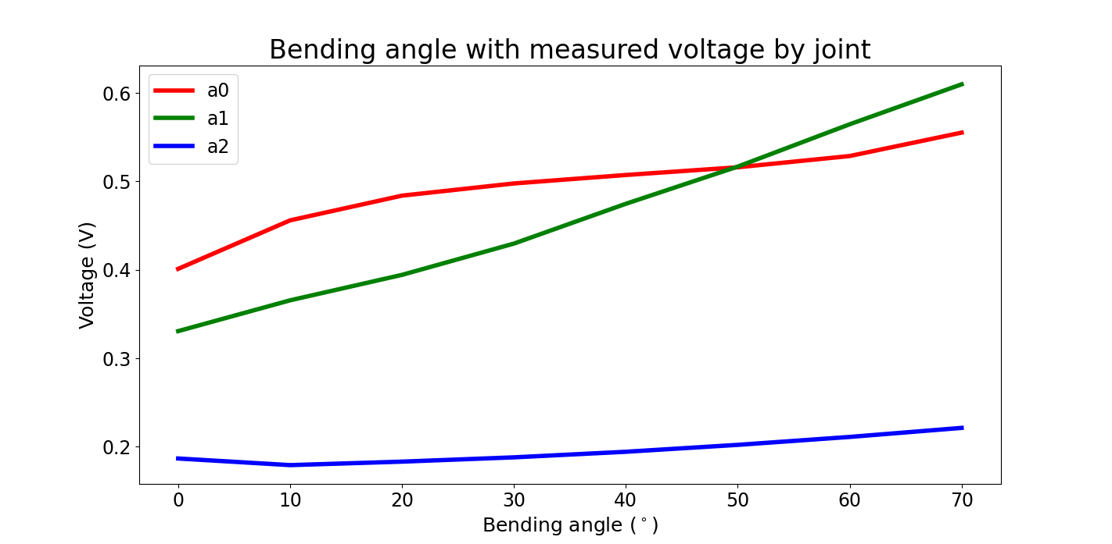
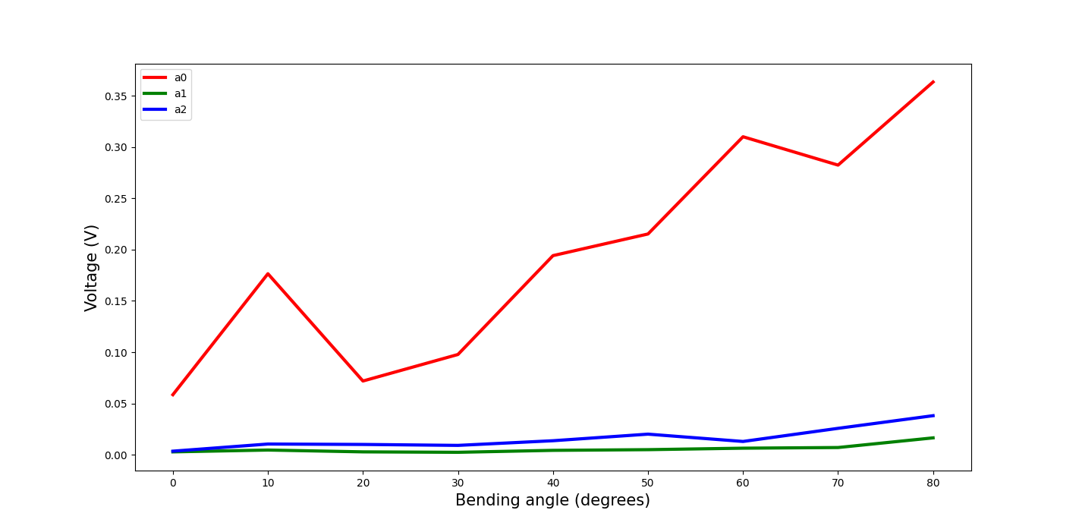
Results – EIT data with actuator bending
Voltages against SDM actuator cable pull distance
Bending angle with measured voltage by joint
Time (samples)
EIT signals of joints change when finger is actuated
EIT signal change nonlinearly as bending angle increases

Slide 14
Discussion
While some materials are compliant or could be considered “soft”, they are not all suitable to work with a fluid-actuated system
A simple 6-electrode EIT chamber was added to a soft robot actuator and could provide sensing signals as to the shape change of the actuator
As soft robots are naturally compliant and flexible, using a similarly soft sensor still allows the robot to move freely
Future work includes:
Advanced ML techniques applied to large data sets
Develop chamber with more electrodes to acquire more detailed sensor data (using an FPC)
Assemble multiple fingers together to create a grasper, and evaluate the performance of the fingers on grasping and object recognition tasks (from EIT data alone)

Slide 15
References
References to be inserted

Slide 16
Questions?

Slide 17
Appendix A
I think it would be a good idea to put in some additional images/text, in case anyone asks about things I’m not already presenting on. This will be added today

